Slide 1


















CORONA VIRUS ANALYSIS
PARTHASARATHY J

Slide 2








CORONA VIRUS
The CORONA VIRUS (COVID-19) pandemic has had a significant impact on public health and has created an urgent need for data driven insights to understand the spread of the virus. As a data enthusiast i have assigned a task to analyze the corana virus datset and to derive meaningful insights from this data.

Slide 3
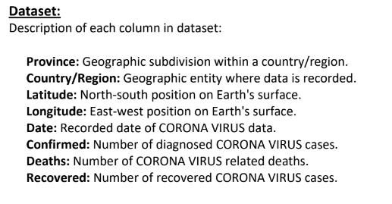

DATA DESCRIPTI0N

Slide 4

TOOLS USED FOR ANALYSIS
Microsoft SQL Server management Studio
SQL Server Management Studio (SSMS) is an integrated environment for managing any SQL infrastructure. Use SSMS to access, configure, manage, administer, and develop all components of SQL Server, Azure SQL Database, SQL Server on Azure VM.

Slide 5

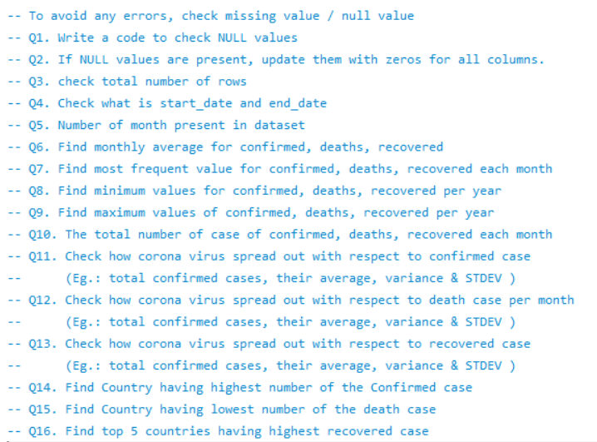
KEY QUESTIONS

Slide 6
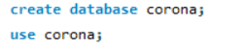

ANALYSIS
STEP 1:
Create a database/schema named corona.
select the database that you want to work with the USE function.

Slide 7
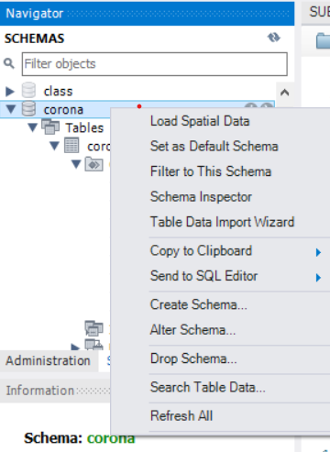

STEP 2:
using Table Data Import Wizard import the dataset to the database.
.xls file for excel file data / .csv file for text file data.
This might take time to import the data with respect to the size of the dataset.

Slide 8

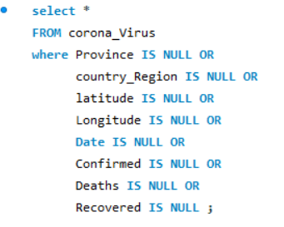
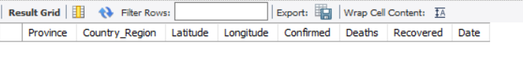
Query 1:
To avoid any errors, check missing value / null value
Write a code to check NULL values
OUTPUT:
INFERENCE:
There is no missing values/ null values present in the data.

Slide 9

Query 2:
If NULL values are present, update them with zeros for all columns.
INFERENCE:
Since there is no missing values/ null values present in the data we dont need to update them to zeros for all columns .

Slide 10

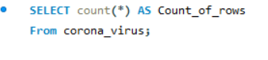
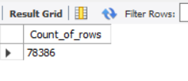
Query 3:
Check total number of rows
OUTPUT:
INFERENCE:
The query executed and results in the output as total count of rows is 78,386.

Slide 11

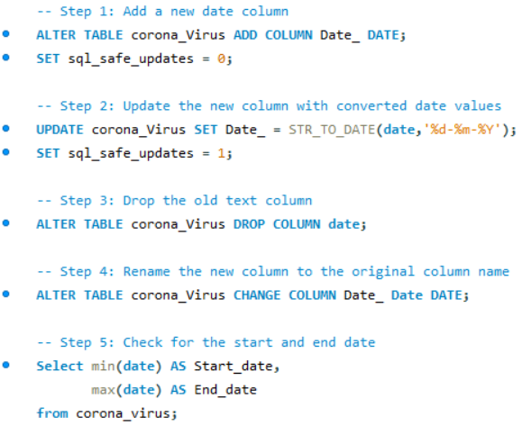
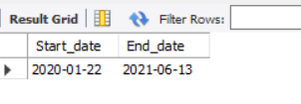
Query 4:
Check what is start_date and end_date
OUTPUT:
INFERENCE:
Since the data has different ‘date’ format it need to be updated to the required format.
By default the SQL has safe mode enabled which prevents the data’s being updated so it needs to be turned off before we update the date format.
Start date of corona is 2020-jan-22
End date of corona is 2021-jun-13
As per the dataset.

Slide 12

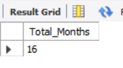
Query 5:
Number of month present in dataset
OUTPUT:
INFERENCE:
The total number of months present in the dataset is 16 months.

Slide 13
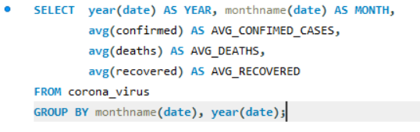
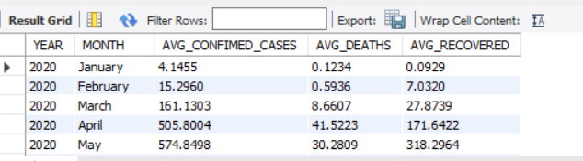
Query 6:
Find monthly average for confirmed, deaths, recovered
OUTPUT:

Slide 14
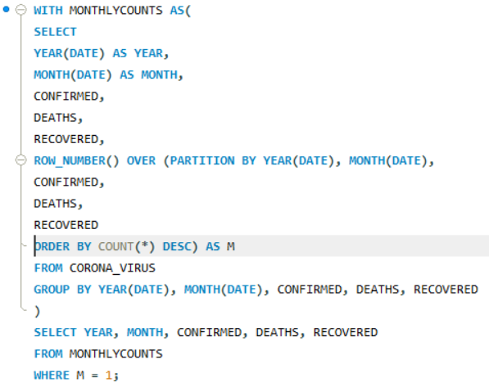
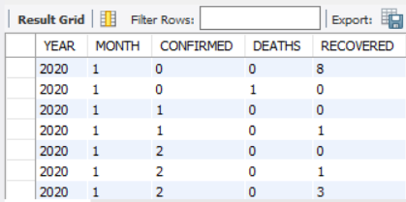
Query 7:
Find most frequent value for confirmed, deaths, recovered each month
OUTPUT:

Slide 15
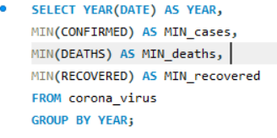
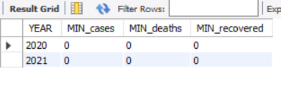
Query 8:
Find minimum values for confirmed, deaths, recovered per year
OUTPUT:

Slide 16
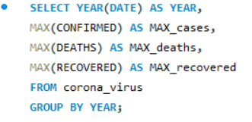
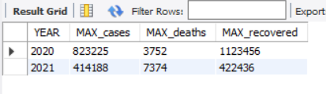
Query 9:
Find maximum values for confirmed, deaths, recovered per year
OUTPUT:

Slide 17

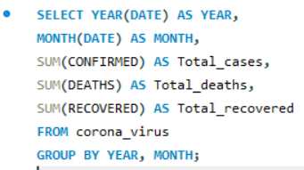
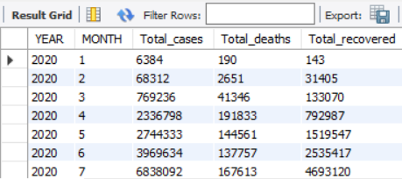
Query 10:
The total number of case of confirmed, deaths, recovered each month.
OUTPUT:

Slide 18

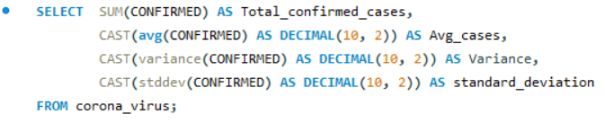
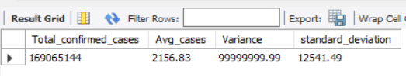
Query 11:
Check how corona virus spread out with respect to confirmed case.
OUTPUT:

Slide 19

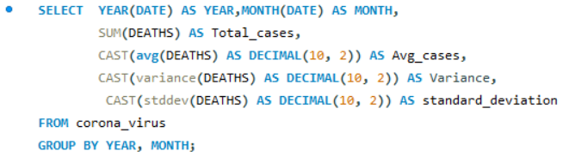
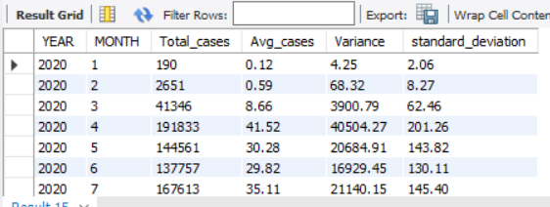
Query 12:
Check how corona virus spread out with respect to death case per month
OUTPUT:

Slide 20

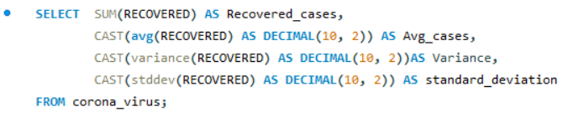
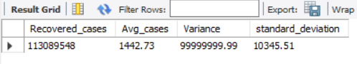
Query 13:
Check how corona virus spread out with respect to recovered case.
OUTPUT:

Slide 21

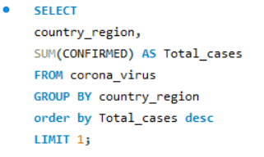
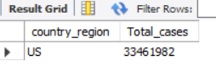
Query 14:
Find Country having highest number of the Confirmed case.
INFERENCE:
The country that has highest number of confirmed cases was US with 33461982 total cases.
OUTPUT:

Slide 22

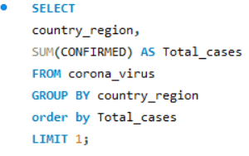
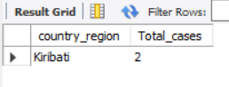
Query 15:
Find Country having lowest number of the death case.
INFERENCE:
The country/region that has lowest number of confirmed cases was Kiribati with 2 cases.
OUTPUT:

Slide 23
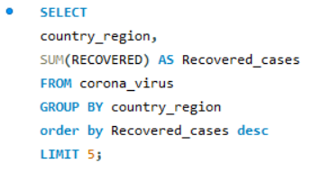
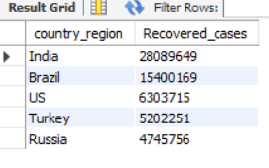
Query 16:
Find top 5 countries having highest recovered case.
OUTPUT:
INFERENCE:
The top five country/region that has highest recovery case was India, Brazil, US, Turkey, Russia.

Slide 24

THANK YOU

